Slide 1
WP3 – Training Material for Teachers
Module 7
Facilitating Intergenerational Learning

Slide 2
Module 7 (Teachers)
Facilitating Intergenerational Learning
Topic 1: Foundations of Intergenerational Learning & Core Principles

Slide 3
Module 7 (Teachers): Facilitating Intergenerational Learning
Topic 1: Foundations of Intergenerational Learning & Core Principles
What is intergenerational learning (IGL)?
Redefining the classroom hierarchy.
IGL is more than just bringing generations together;
it is a reciprocal exchange where both age groups
are teachers and learners simultaneously.
Key points: Mutuality, breaking hierarchies, and shared digital discovery.
Notes:
"Welcome everyone! Today we are getting into the topic of intergenerational learning. It’s a process where both generations contribute and learn from, with and about each other. It can be seen as a circle of mutual exchange rather than the traditional top-down hierarchy of somebody older teaching somebody younger. "

Slide 4
Module 7 (Teachers): Facilitating Intergenerational Learning
Topic 1: Foundations of Intergenerational Learning & Core Principles
The 5 Didactical Pillars
The didactical foundation of every activity.
Successful IGL relies on:
  Mutuality: Everyone gives and receives.
  Structured Interaction: Clear, organized tasks and rules.
  Accessibility: Removing physical, emotional and digital barriers.
  Reflection: Thinking about the "we" and thereby learning to value each other.
  Participation: Active involvement of every participant.
Notes:
"These five pillars are our foundation. Mutuality ensures everyone benefits. Structure keeps us on track, Accessibility makes our learning environment inclusive thereby giving everybody the chance to participate actively. Reflection allows us to process the experience, and Participation ensures everyone has a voice."

Slide 5
Module 7 (Teachers): Facilitating Intergenerational Learning
Topic 1: Foundations of Intergenerational Learning & Core Principles
Impact on Teachers and Students
Cultivating Connection through Communication.
Teachers act as mediators between different socializations.
IGL helps students develop patience, confidence, communication skills
and helps seniors overcome tech-anxiety and keeps them socially integrated.
Key points: Civic engagement, communication skills, and digital inclusion.
Notes:
For your students, intergenerational learning is a powerful exercise in social and emotional learning. When they explain everyday digital practices—like how to search online or use an app—they practise patience, empathy, and clear communication. At the same time, senior participants benefit by feeling less isolated and more confident in engaging with digital tools. What makes IGL special is that both sides learn and grow together, each contributing different strengths.”

Slide 6
Module 7 (Teachers): Facilitating Intergenerational Learning
Topic 1: Foundations of Intergenerational Learning & Core Principles
Activity: The "Aha!" Moment (Interactive)
Task: Tapping into personal experiences with IGL
Interaction:
The teachers reflect on a time they learned something from
and with someone much older or younger.
It can be two different scenarios or one.
Green (sticky) note: Write what was learned.
Yellow (sticky) note: Write down how it felt.
Note: This exercise can also be visualized on a digital board
.
Notes:
“Let’s start with your own experience. Think of a moment when you learned something from or with someone from a different generation. It could be one situation or two separate ones. By reflecting on this, we remind ourselves that intergenerational learning is a natural part of everyday life. This activity helps us reconnect with the feeling of mutuality—the shared learning experience we later want to create for our students and senior learners.”

Slide 7
Module 7 (Teachers): Facilitating Intergenerational Learning
Topic 1: Foundations of Intergenerational Learning & Core Principles
Activity: The Principles Gallery (Interactive)
Task: Translating abstract pillars into classroom reality.
Interaction: Visit 5 posters (one for each pillar).
Green Flag: Write a sign the principle is working.
Red Flag: Write a sign the principle is missing.
.
Notes:
Let’s make the principles more concrete. Around the room, you’ll find posters for the five core principles of intergenerational learning. Your task is to think in terms of green flags and red flags—clear indicators of whether a principle is being met.
For example, if you see a senior and a student both engaged with the tablet, talking and laughing together, that’s a green flag for mutuality. If the student is doing all the clicking while the senior remains passive, that’s a red flag. Please add your own observations to the posters.”

Slide 8
Module 7 (Teachers)
Facilitating Intergenerational Learning
Topic 2: Managing IGL (Dynamics & Conflict)

Slide 9
Module 7 (Teachers): Facilitating Intergenerational Learning
Topic 2: Managing IGL (Dynamics & Conflict)
Navigating the Age Gap
Different Worlds, Different Tempos
Seniors may fear "breaking" technology, while students value "trial-and-error" speed.
Your role is to bridge these socialization styles.
Key points:
Understanding fear vs. fluency and managing expectations
Notes:
“Your students live in an ‘Undo’ world, where mistakes can be reversed instantly. Seniors, on the other hand, often experience technology as fragile and worry about ‘breaking’ it. Add to this different communication styles, stereotypes about age or competence, and unclear roles, and tensions can arise quickly. Your role as a facilitator is to recognise these differences early and actively bridge these gaps—between speeds, expectations, and perspectives.”

Slide 10
Module 7 (Teachers): Facilitating Intergenerational Learning
Topic 2: Managing IGL (Dynamics & Conflict)
Common Friction Points
Spotting Trouble Early
Watch for:
  The Pacing Gap: Students moving too fast.
  The Language Barrier: Tech-jargon (e.g., "The Cloud"), slang, overly formal language.
  Withdrawal: Seniors feeling they are "burdensome."
  Role misunderstanding: Seniors may take on the traditional role of the teacher.
  Stereotypes: Stereotypes like “younger generations are lazy” can hinder building connections
Notes:
“When working intergenerationally, friction often shows up in small moments. Pay close attention to signals such as students moving too fast, using unfamiliar slang, taking over tasks, or seniors beginning to withdraw. A phrase like ‘I’ll just do it’ is often a warning sign—not of bad intentions, but of a mismatch in pace or confidence. These are the moments where your role as a facilitator becomes crucial: gently slow things down, invite both voices back in, and re-establish shared participation before disengagement sets in.”

Slide 11
Module 7 (Teachers): Facilitating Intergenerational Learning
Topic 2: Managing IGL (Dynamics & Conflict)
The Facilitator’s Toolbelt
Intervention Strategies
  Reframing: Putting something negative into a more positive context like "He isn't slow; he is precise."
  Supporting communication (The Hands-Off Rule): Make students guide with words and practice active listening.
  Pause, Reset and Reflect: Stopping pairs that are getting into a conflict and allowing them to take a break to reflect
Key points:
Empowerment over completion
Notes:
“Think of facilitation as having a small toolbelt you can draw from. Tools like pausing the activity, rephrasing instructions, reframing a task, or introducing turn-taking can quickly restore balance. One helpful strategy is encouraging students to step back physically—leading with their words rather than their hands. When seniors control the mouse or device, learning stays active. Your role is to notice when to intervene lightly and when to let interaction unfold.”

Slide 12
Module 7 (Teachers): Facilitating Intergenerational Learning
Topic 2: Managing IGL (Dynamics & Conflict)
Activity: The Facilitator’s Lab (Interactive)
Task: The "Turbo Student" Role Play.
Interaction:
In trios: One "Turbo" student (impatient), one "Hesitant" senior, and one Facilitator.
Practice a 2-minute intervention using the "Hands-Off Rule."
Notes:
"Now it’s time to practise. In this role play, one person takes on the role of the facilitator, one plays a student, and one plays a senior learner. The goal is not to complete the digital task, but to observe interaction and practise facilitation moves. Pay attention to power imbalances, pace, and participation. As the facilitator, your task is to step in when needed—slowing things down, inviting voices back in, and supporting shared control of the activity.”

Slide 13
Module 1 (Students): Screen On and Screen Off Time
Topic 2: Managing IGL (Dynamics & Conflict)
Activity: Role Play Debrief (Interactive)
Task: The "Feeling" Check
Interaction:
Seniors/Students: “Did the facilitator make you feel like a team?”
Facilitators: “What was the hardest part of not doing the tech task yourself?”
Notes:
"Reflection is a core pillar. Ask yourself: did the facilitator build a bridge or just solve a problem? We want to build confidence and relationships, not just digital outputs."

Slide 14
Module 7 (Teachers):
Facilitating Intergenerational Learning
Topic 3: Matching and Pairing

Slide 15
Module 7 (Teachers): Facilitating Intergenerational Learning
Topic 3: Matching and Pairing
The Art of the Match
Designing Synergy
-Matching is the strategic grouping done before the session;
-Pairing is the lived interaction during it.
-Matching and pairing is an individual process and does not have to be finalized right away!
Rematches are often necessary and no sign of a bad matching process!
Notes:
"Matching is a science; pairing is an art. It starts with knowing your students—their interests, strengths, and learning styles—and ends with observing how they interact in the first few minutes of the session. Matching means selecting students whose skills or knowledge complement each other. Pairing is the art of arranging them so they collaborate effectively and stay engaged."

Slide 16
Module 7 (Teachers): Facilitating Intergenerational Learning
Topic 3: Matching and Pairing
Creating Synergy Pairs
More Than Just Random Names
  Criteria for High-Synergy Pairs
  Complementary Fit: Based on complementary strengths (Tech-pro + Life-expert).
  Commonality: Shared hobbies (e.g., gardening and taking walks).
  Socio-Emotional: Pairing personality types (e.g., calm with anxious).
  Cultural background: Pairing based on cultural knowledge or background.
  Key points:
  Data-driven pairing leads to better outcomes
Notes:
"Don’t just match participants by technical skill. Consider their complementary strengths, cultural background, common interests, and socio-emotional needs. Matching by 'vibe' is powerful—if two participants share a passion, like local football, they’ll naturally find ways to navigate tasks together because they are excited about the content."

Slide 17
Module 7 (Teachers): Facilitating Intergenerational Learning
Topic 3: Matching and Pairing
The First Meeting
Breaking the Ice
The first 15 minutes of a common activity are a "Trial Period."
As a facilitator, observe body language and verbal flow to see
if the matches need adjustment.
Key points:
Observation, "dating phase," and intervention
Notes:
The first 15 minutes are a trial period. Walk the room. If a pair is silent, they might need an icebreaker or a quick adjustment. It is okay to swap pairs early if the synergy isn't there!"

Slide 18
Module 7 (Teachers): Facilitating Intergenerational Learning
Topic 3: Matching and Pairing
Activity: The Matchmaker Challenge (Interactive)
Task: Quick-Fire Pairing
Interaction:
Using 6 Persona Cards (3 students, 3 seniors), create 3 pairs in 5 minutes.
You must have a 1-sentence rationale for each.
Notes:
"Look for the subtle clues in their profiles. Why does 'Impatient Ivan' need 'Calm Clara'? Ready, set, match!"

Slide 19
Module 7 (Teachers): Facilitating Intergenerational Learning
Topic 3: Matching and Pairing
Activity: The "Pitch" (Interactive)
Task: Defending the Match
Interaction:
"Pitch" your pairings to a partner.
They must play "Devil's Advocate" and find one potential conflict in your pair.
Notes:
"Pitch your logic. If your partner sees a risk you missed—like two very dominant personalities—it helps us prepare for actual facilitation challenges!”

Slide 20
Module 7 (Teachers):
Facilitating Intergenerational Learning
Topic 4: Co-Creation

Slide 21
Module 7 (Teachers): Facilitating Intergenerational Learning
Topic 4: Co-Creation
The "Power of With"
Leading "With," Not "To."
Co-creation means the project goal is decided together.
The teacher provides the frame, but the participants the content.
Everybody is included in this process.
Notes:
"Co-creation is a collaborative process where all participants actively shape the learning experience. Everyone contributes ideas, expertise, and perspectives—no one just receives instructions. It’s dialogical and creative: shared responsibility, open communication, and collective problem-solving. At its core, co-creation answers the question: 'How can we create something together that none of us could create alone?' Your role shifts from being a 'Teacher' to a 'Host' of this collaborative conversation."

Slide 22
Module 7 (Teachers): Facilitating Intergenerational Learning
Topic 4: Co-Creation
The Co-Creation Process
Steps to a Shared Project
  Ideation: Both ages suggest topics.
  Synthesis: Merging ideas into one goal.
  Consensus: Ensuring both feel represented.
Key points:
Moving from "helping" to "collaborating."
.
Notes:
“First, connect by welcoming participants and setting a shared purpose. Then discover and explore experiences and assumptions. Next, agree and create solutions together. Finally, do and reflect on the results. The focus is moving from ‘helping’ to true collaboration, with all voices heard."

Slide 23
Module 7 (Teachers): Facilitating Intergenerational Learning
Topic 4: Co-Creation
Methods for Digital Co-Creation
The "Working Together" Framework
  Shared Storytelling: Using tools like Book Creator or Canva to merge oral history with digital design.
  Joint Mapmaking: Creating Mapstories to connect memories with students' tech skills.
  Collaborative Design: Utilizing Padlet or Mentimeter to vote on themes and collect shared resources.
Notes:
"Digital tools can make co-creation more engaging and accessible. Shared Storytelling lets participants combine stories and visuals using apps like Book Creator or Canva. Joint Mapmaking connects memories or experiences to digital maps, making abstract ideas tangible. Collaborative Design tools, like Padlet or Mentimeter, help the group vote on themes, share resources, and make decisions together. These methods keep everyone involved and ensure the process is truly collaborative."

Slide 24
Module 7 (Teachers): Facilitating Intergenerational Learning
Topic 4: Co-Creation
Activity: The Co-Creation Sprint (Interactive)
Task: Designing a Joint Task
Interaction:
In groups teachers, design a 1-sentence project idea.
Rotate the "Moderator" role every 3 minutes
(Brainstorming > Synthesis > Consensus)
Notes:
"This is a speed-run of facilitation. Moderators, your goal is to make sure every voice is heard during the design phase."

Slide 25
Module 7 (Teachers): Facilitating Intergenerational Learning
Topic 4: Co-Creation
Activity: The 2030 Headline (Interactive)
Task: The Future of Digital Harmony
Interaction:
Imagine it's 2030.
What is the headline in your local paper about your IGL program?
(e.g., "Seniors find tech-wings, Students find history").
Notes:
"As we close, look to the future. What impact will your IGL program have? Write that headline. This is the legacy you are building through Digital Harmony. Great job today!"

Slide 26
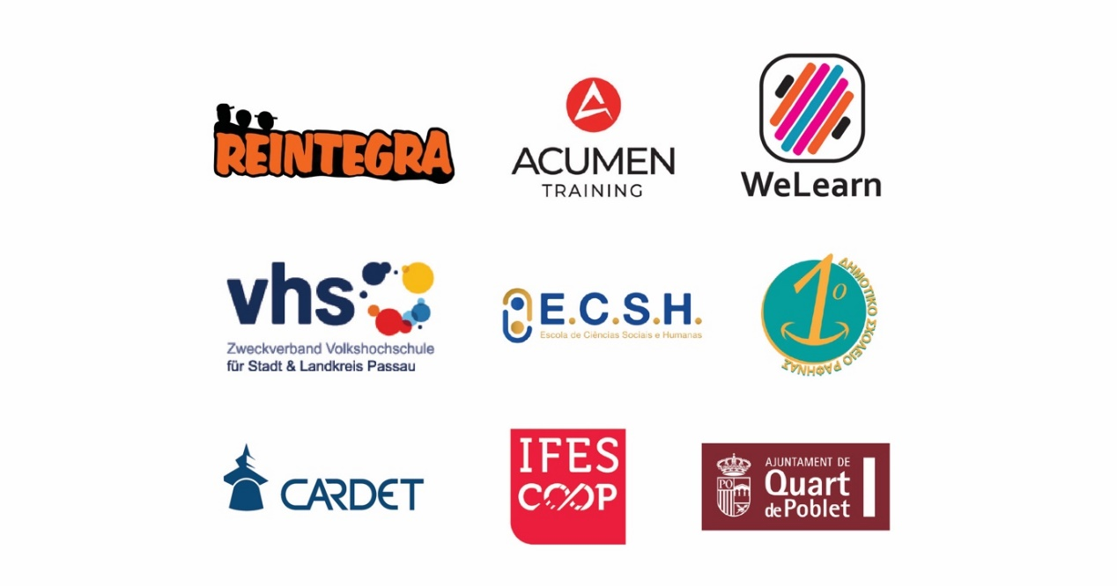
End Module 7 (Teachers):
Facilitating Intergenerational Learning

